Slide 1
MILK IN MINUTES
K RISHI

Slide 2
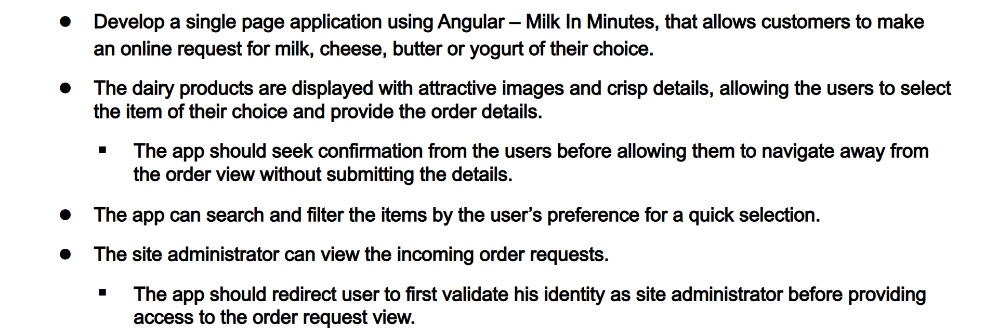
OBJECTIVE

Slide 3

KEY FEATURES
PRODUCT LISTING WITH DETAILED DESCRIPTION AND IMAGES
SHOPPING CART MANAGEMENT WITH THE ABILITY TO ADD AND UPDATE ITEMS
USER AUTHENTICATION FOR SECURE LOGIN
SEARCH AND FILTER CATEGORY
USER – FRIENDLY BROWSING

Slide 4





TECHNOLOGIES / FRAMEWORKS
“ANGULAR (v17.2.1) – FRONTEND DEVELOPMENT FRAMEWORK FOR BUILDING ROBUST WEB APPLICATIONS”
“TYPESCRIPT – SUPERSET OF JAVASCRIPT FOR WRITING SCALABLE AN MAINTAINABLE CODE”
“HTML AND CSS – MARKUP AND STYLING LANGUAGES FOR STRUCTURING AND DESIGNING WEB PAGES”
“BOOTSTRAP” – FRONTEND FRAMEWORK FOR BUILDING RESPONSIVE AND MOBILE – FRIENDLY DESIGNS
“JSON-SERVER (V1.0.0-alpha.23) – HOSTING THE JSON FILES LOCALLY”

Slide 5
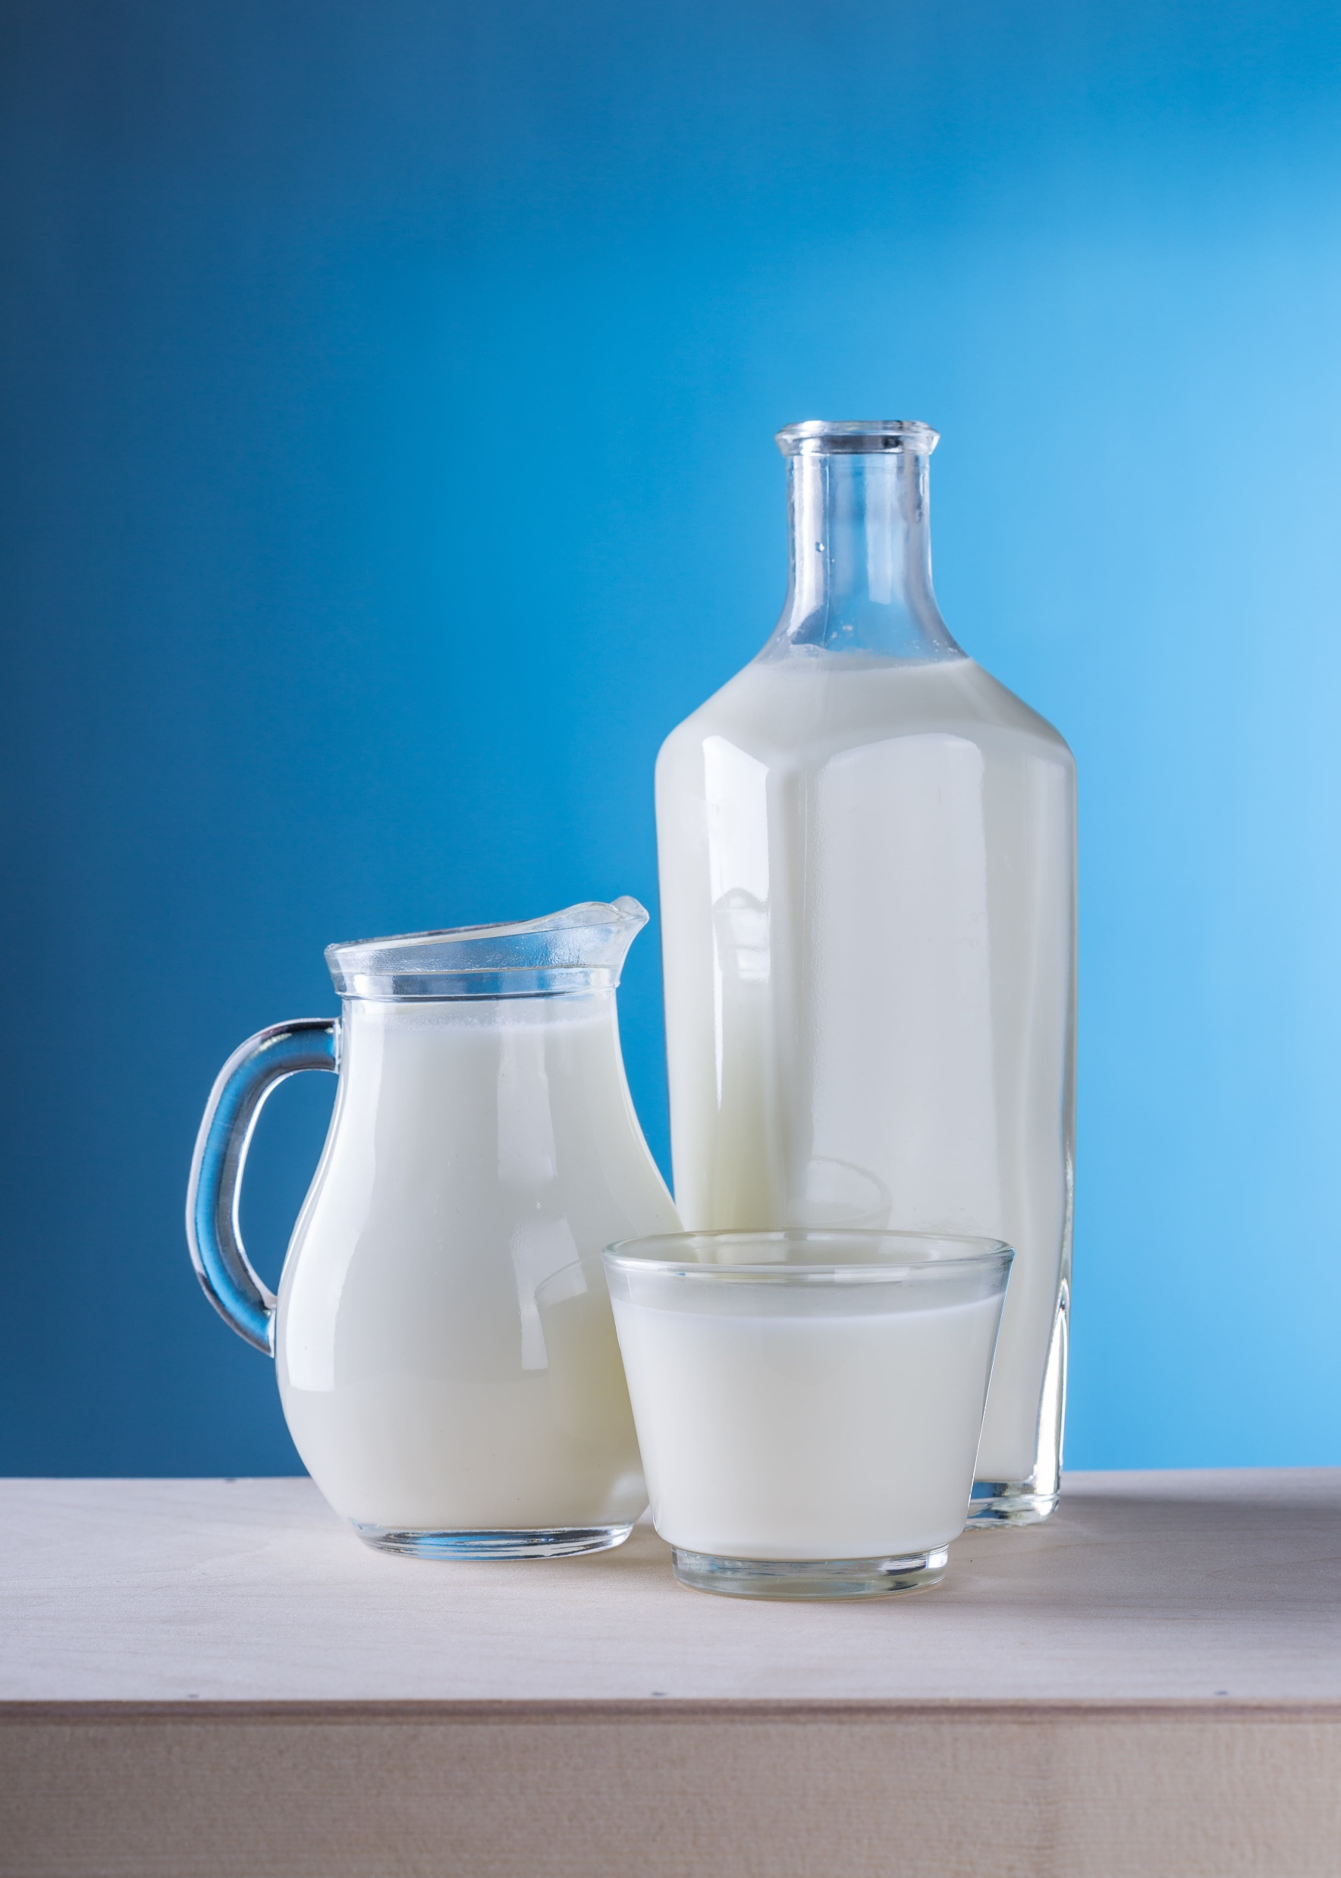
COMPONENTS/SERVICES/GUARDS
HEADER
HOME
FOOTER
PRODUCTS
CART
SIGN-IN
SIGN-UP
ADMIN
ORDER-REQUESTS
SERVICES (USER,PRODUCT,AUTH,ORDER,CART,ADMIN)
GUARD(AUTH)

Slide 6

PROMPTS
Create a home page by using angular materials which includes header and footer. In header, at left aligned it should have logo and name and at right aligned it should have navigating names of home, products, cart, admin and signIn. In footer, at left aligned it should have social media icons of whatsapp, instagram, twitter, telegram and pinterest and at right aligned it should have copyright information. In home page, it should have some information of the company "Milk In Minutes". I need header,footer and home page in 3 components and make sure all to combine in 1 component. Use bootstrap if needed
In the header, by clicking on the Products navigator, it should redirect to product page. Create a product page using angular materials, which includes products name, category, sizes, prices, description and image. The details should fetch from Products object. I have the product details on products.json file. In that page, at left aligned i need a category for filtering the products by category and a search bar and at left aligned i need the products to be displayed with 2 columns per row

Slide 7

CHALLENGES
JSON – DATA LOADING
USER AUTHENTICATION
USER EXPERIENCE
REAL – TIME UPDATES
OPTIMIZING WEBSITE PERFORMANCE TO REDUCE LOAD TIMES
PLANNING AND SCALABILITY

Slide 8

CONCLUSION
MilkInMinutes revolutionizes dairy shopping with a seamless online platform. Offering a diverse range of dairy products, intuitive navigation, we've created a user-centric shopping experience. Despite challenges, our team's dedication ensured the site's reliability, data security, and user satisfaction. Moving forward, we remain committed to continuous improvement, innovation, and delivering exceptional service to our valued customers.

Slide 9


